Slide 1
OceanStor Dorado V6 Technical Deep Dive
Security Level: Internal Only

Slide 2
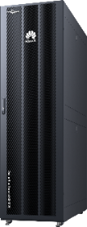
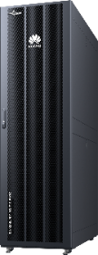
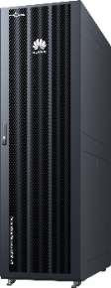
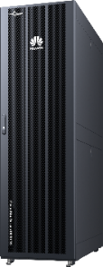

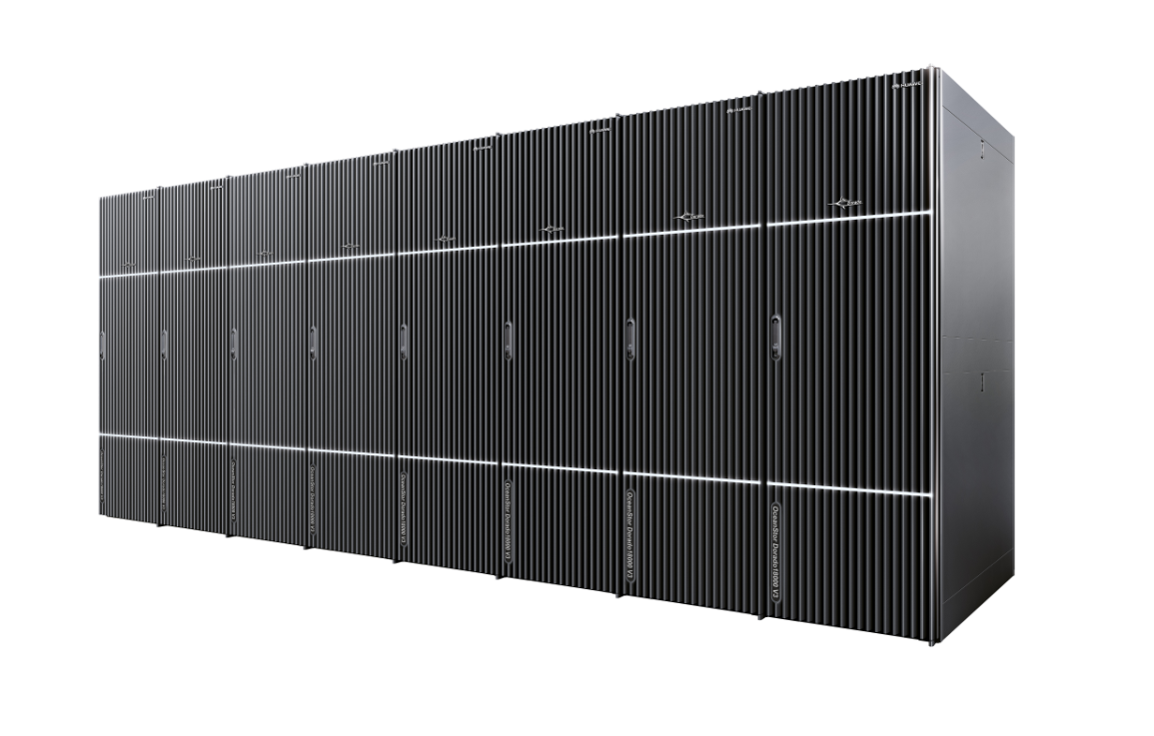
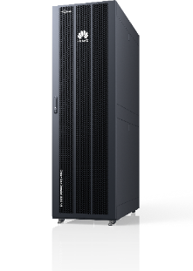
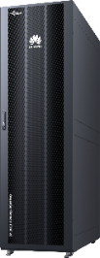
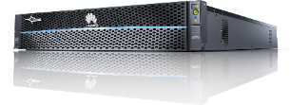
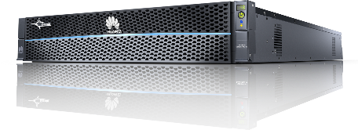
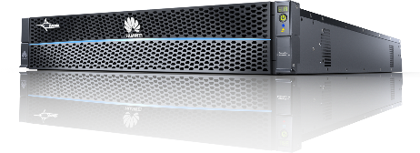
Overview of OceanStor Dorado V6
Entry-Level
Mid-Range
High End
高端
Dorado18000 V6
Dorado8000 V6
Dorado6000 V6
Dorado3000 V6
Dorado5000 V6
 | Entry-Level | Mid-Range |  | High End
Type | Dorado3000 V6 | Dorado5000 V6 | Dorado6000 V6 | Dorado8000 V6 | Dorado18000 V6
Height / Controllers of each Engine | 2U/2C | 2U/2C | 2U/2C | 4U/4C | 4U/4C
Controller Expansion | 2-16 | 2-16 | 2-16 | 2-16 | 2-32
Maximum Disks | 1200 | 1600 | 2400 | 3200 | 6400
Cache/Dual Controller | 192G | 256G/512G | 512G/1024G | 512G/1024G/2048G | 512G/1024G/2048G
Front-end ports | 8/16/32G FC, 1/10/25/40/100G Ethernet
Back-end ports | SAS 3.0 | SAS 3.0/100G Ethernet
Notes:
OceanStor Dorado V6 is the latest generation of Huawei’s flagship enterprise AFA storage system.
There are 3 series within this product line, covers entry level, mid-range and high end respectively.
3000 series is the entry level, minimal unit comes in as 2U 2C system, expandable up to 16 controllers.
Go through the table

Slide 3
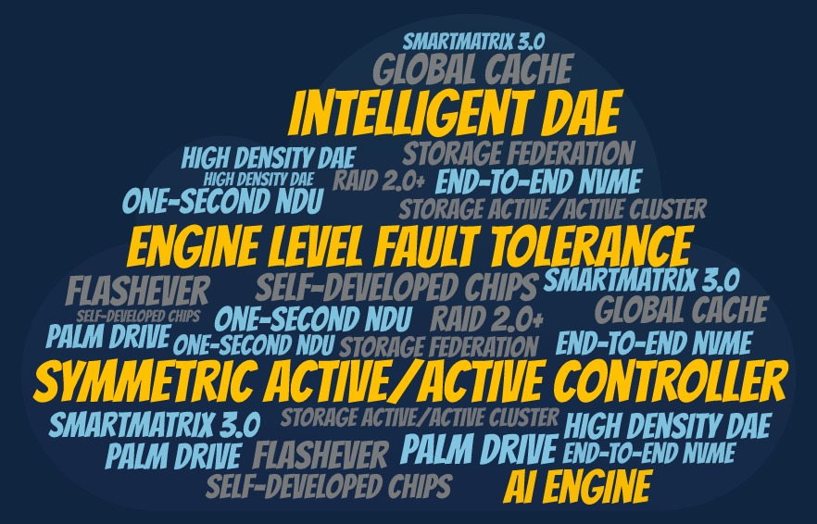
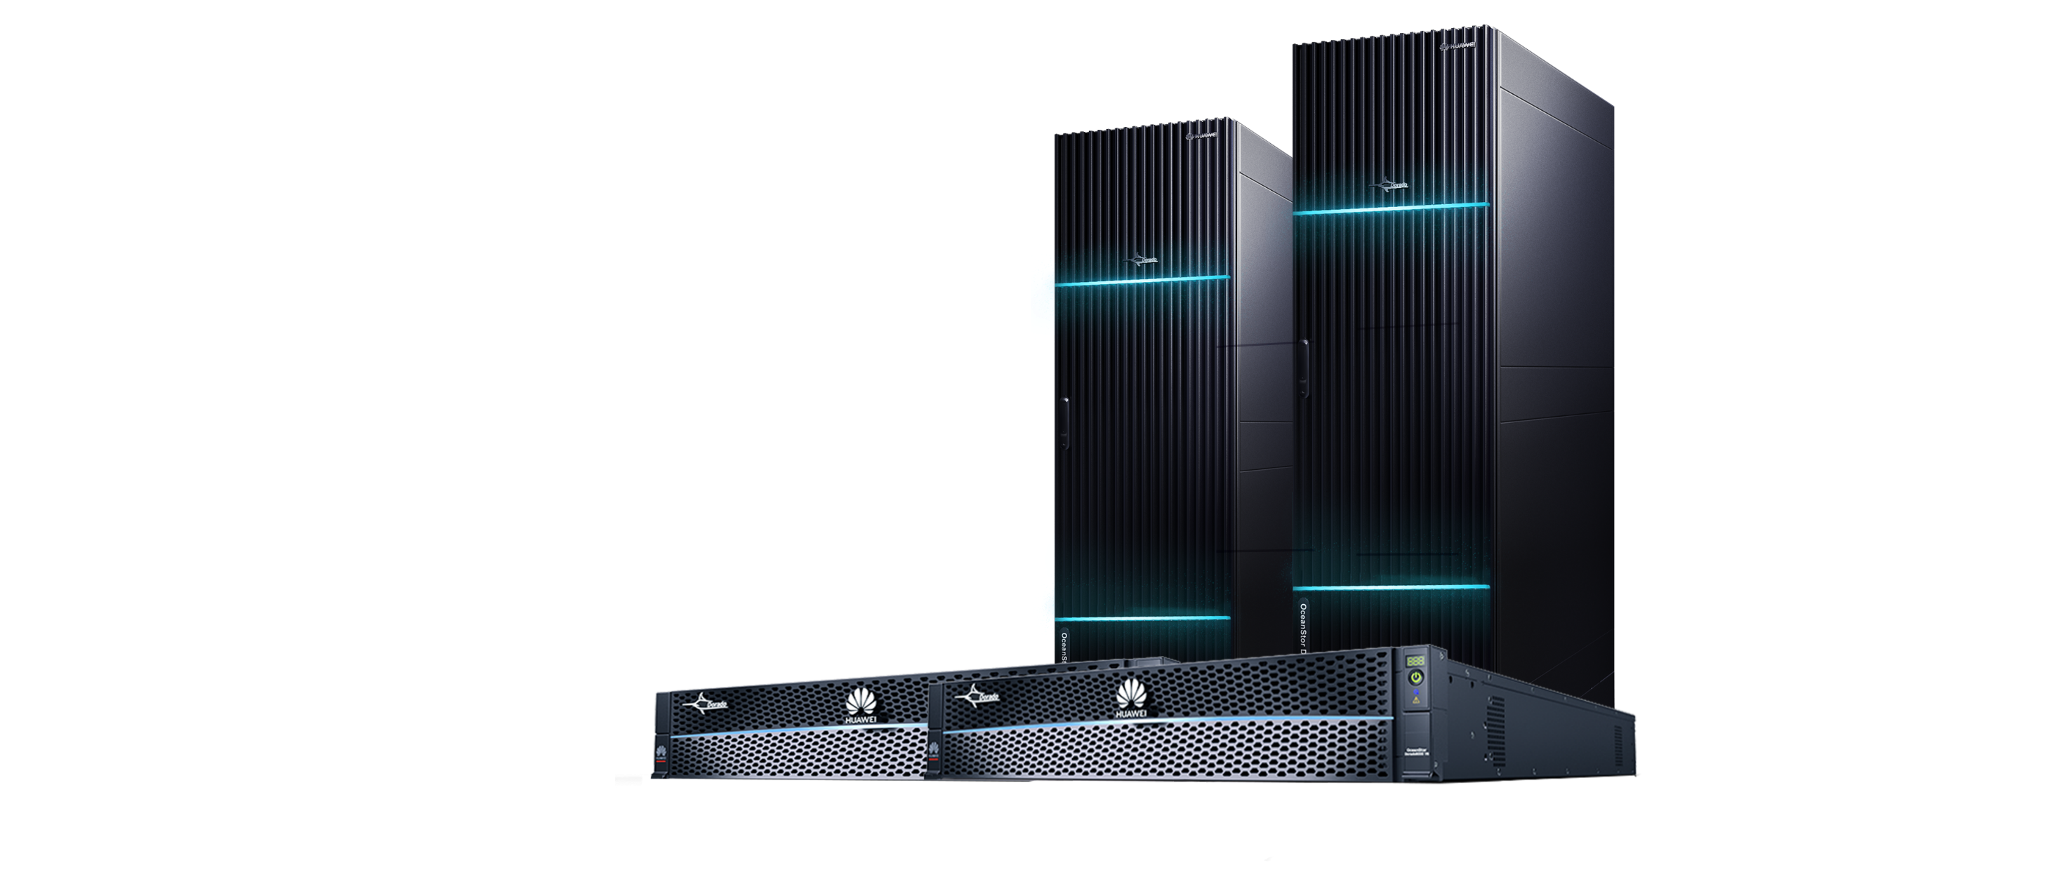
OceanStor Dorado V6: The Cutting Edge of Storage Innovation
Notes:
We know that the OceanStor Dorado series products are representative of native all-flash, and are widely welcomed by customers in the market.
In Gartner’s magic quadrant research 2019, Dorado is in the leader quadrant on the top right corner.
There are many great features and innovations packed in Dorado V6, some highlighted here like intelligent DAE, we will dive into more details of many of them in this training.

Slide 4
Hardware
Design
Extreme
Reliable
Extreme
Performance
High
Efficiency
Notes:
The training is broken down into 4 sections as shown here, we will take a short break in the middle, and then open Q&A session at then end.
So please take a note of your questions and leave them to the end.

Slide 5
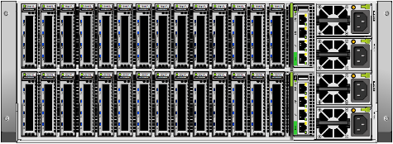
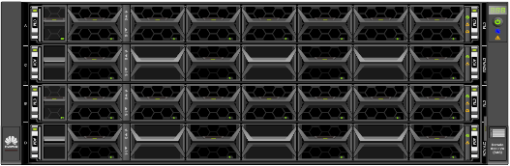
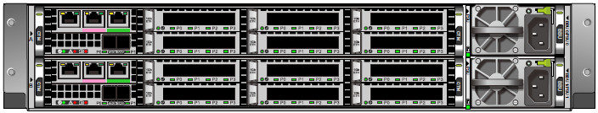
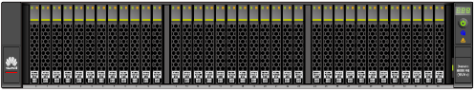
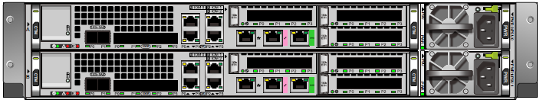
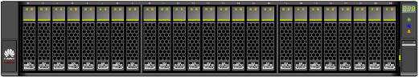
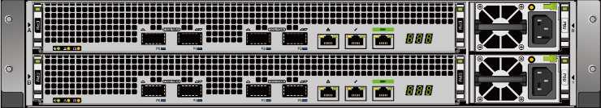
Extremely Reliable
Extreme Performance
Cost Effective
New Generation Innovative Hardware Platform
Rear Panel
Front Panel
High-end controller enclosure
4U, 28 shared interface slots
4U, 4 controllers per controller enclosure
Mid-range controller enclosure
2U, 2 controllers per controller enclosure
Entry-level controller enclosure
2U, 36 NVMe SSDs(high density)
2U, 2 controllers per controller enclosure
Intelligent DAE
2U, 25 SAS SSDs
2U, 2 controllers per controller enclosure
Standardization
High density
Notes:
Dorado hardware is design with high density, high performance, and high reliability in mind, for all series from entry level up to high end.
It features fully connected front end and backend, specialty SSD enclosure and pin design, with lots of self-developed chipsets throughout the stack, to help the system to achieve the design target. Dorado hardware has a lot of advantages in many areas compared to major competitors, we will go through the details one by one in this sections.

Slide 6
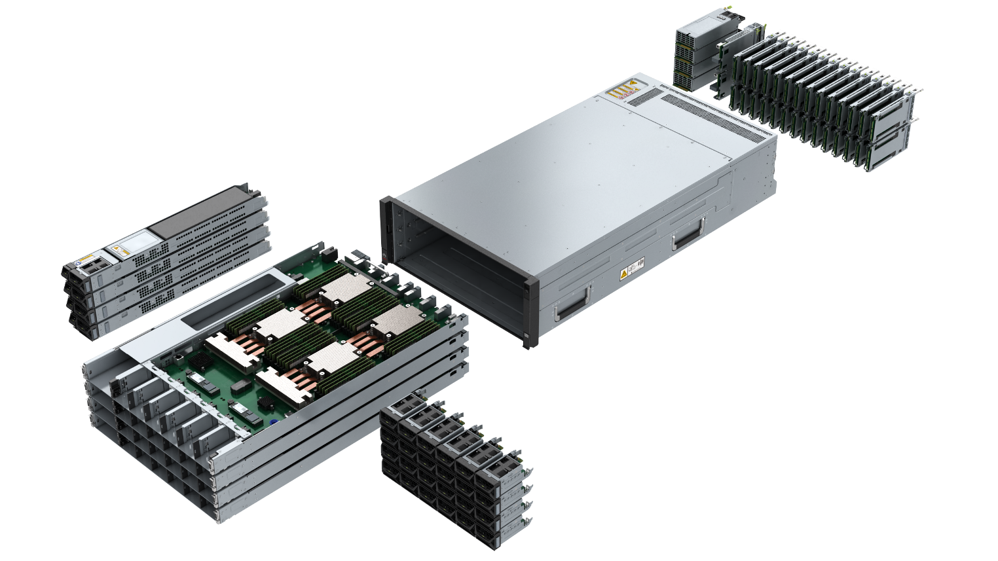
Controller design for high-end series
Extremely Reliable
Extreme Performance
Cost Effective
Notes:
Let us first take a look at the hardware design of the controller engine of Dorado's high-end products (8000/18000).
As can be seen from the figure on the left, all components of the controller engine are redundant, including controllers, fans, interface cards, BBU, PSU, etc., there is no single point failure end-to-end. Even better, all interface components are FRUs, which can be hot-plugged online without affecting business continuity.
On the right side, we have the schematic diagram of the component interconnection within the controller engine.
The key thing to pay attention to is the full mesh connection between components. The four controllers in the engine are fully interconnected through a passive backplane, and the bandwidth between any two controllers is multiple lines of 100GE RDMA network.
The most powerful feature is the shared IO interface module. All IO modules has direct access to all four controllers, which means that any one IO module can directly send I/O to any controller, there is no need to relay through other controllers. Cross-controller forwarding is the typically behavior of all other traditional enterprise storages.
This design greatly reduces I/O latency and eliminates a key single point of failure in the system. Not only data travels less hops, but also less CPU consumption and memory copy.
Similarly, every two PSUs form an available group that can be backed up to each other, each powers half of the components. This means if we configure it properly, even if three of the four PSUs failed, the controller engine can still provide storage service.

Slide 7
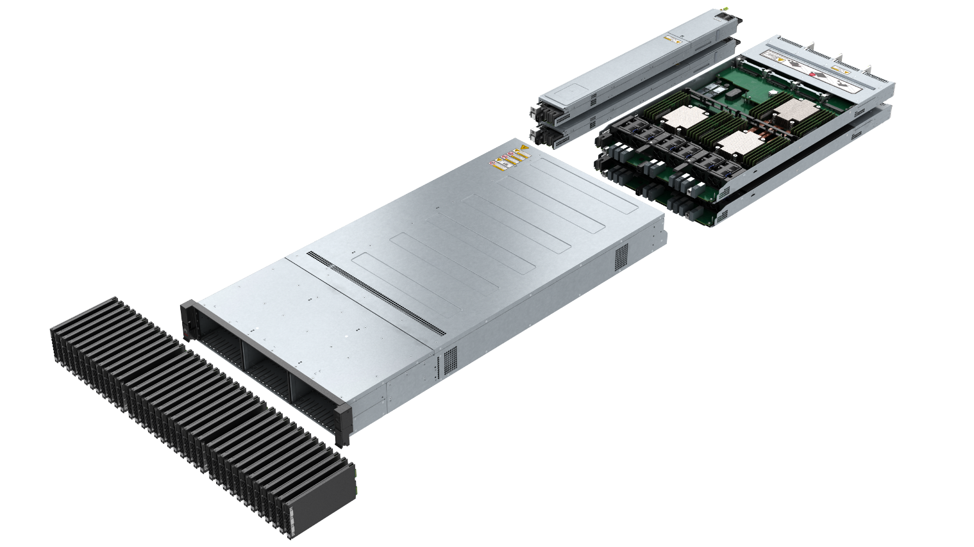
Controller design for Middle-range series
Extremely Reliable
Extreme Performance
Cost Effective
BBU
PSU
PSU
BBU
IO card
IOB
IOB
IO card
100GE
SSD
100GE
SSD
IO card
CPU
SSD
CPU
IO card
CPU
SSD
CPU
IO card
IO card
100GE
FAN
FAN
FAN
FAN
FAN
FAN
FAN
FAN
FAN
FAN
FAN
FAN
Notes:
Next lets look at the hardware design of midrange series of Dorado. Similar to the high-end, all components are redundant and hot-pluggable, but the IO interface module is no longer shared between all controllers and will belong to a specific controller. The key reason is cost effectiveness.
Left side shows the high density SSD media in Dorado V6. In this new generation of Dorado, we innovatively design and introduce an ultra-high density PALM SSD to provide the highest storage density currently available. Compared with the traditional 2.5-inch SSD, we can accommodate up to 36 PALM SSDs in a 2U height space, increasing the capacity density by about 50%. Of course, to achieve this goal, it also needs to be optimized in hardware design, not only the PALM disk itself, but also the heat dissipation challenge brought by high density. Huawei has three patents around this hardware design.

Slide 8
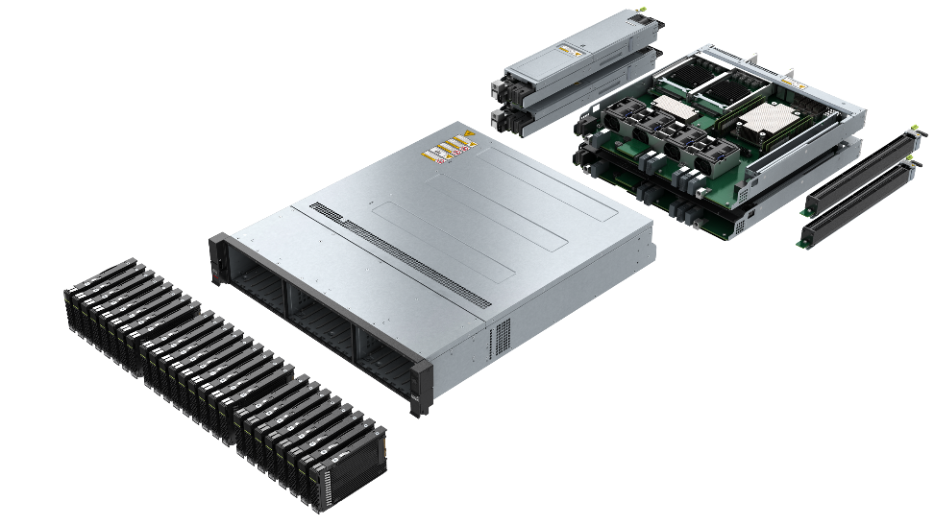
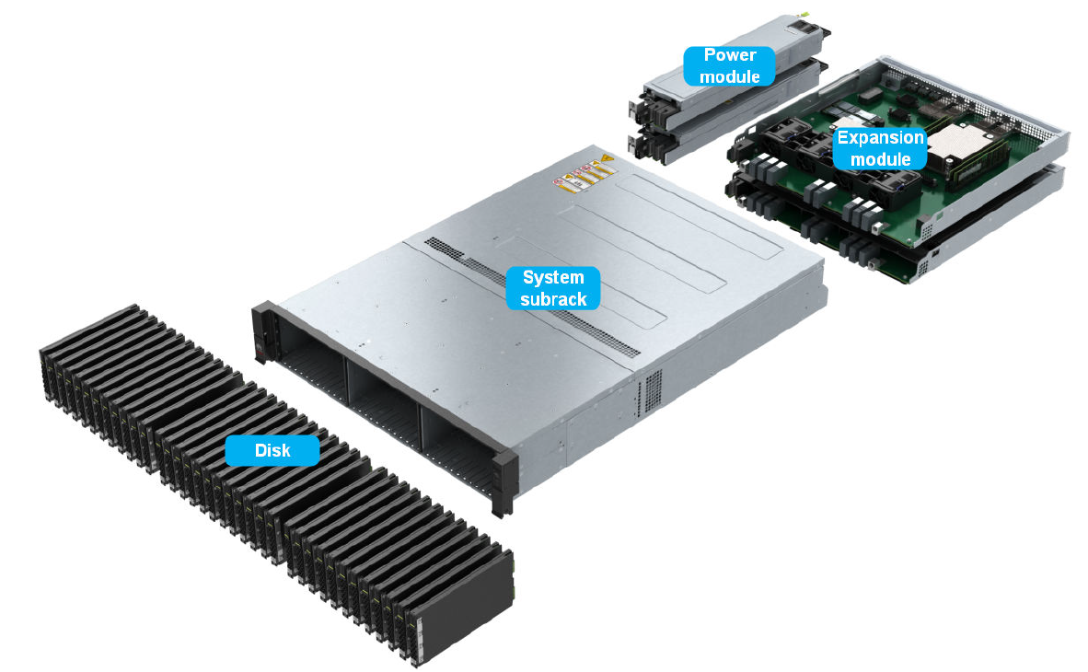
Controller design for Entry-Level series & Intelligent DAE
Extremely Reliable
Extreme Performance
Cost Effective
BBU
PSU
PSU
BBU
IO card
IOB
SSD
IOB
IO card
IO Card
SSD
IO Card
SSD
IO Card
CPU
SSD
CPU
IO Card
100GE
FAN
FAN
FAN
FAN
FAN
FAN
FAN
FAN
FAN
FAN
FAN
FAN
Notes:
Finally, let's look at the hardware design of the entry-level and Intelligent DAE of Dorado. On the whole, the entry-level and mid-range architecture designs are similar, except that the number of CPU cores, memory, and IO interfaces are reduced.
What I want to emphasize is the intelligent DAE, this is a new attractive component in the new generation of Dorado. Unlike traditional disk enclosures, intelligent DAE is more like an entry-level storage. It has its own two controllers, and each controller has its own CPU and memory resources. Besides managing SSDs and translating protocol, the intelligent DAE can do some background tasks that originally required the controller to do, such as data reconstruction, compression, GC, etc., reducing the pressure on the controller, and at the same time, it can greatly improve the overall storage capability.
With intelligent DAE, we can also do some more advanced things, such as implementing the IP network between controllers and disk enclosures, significantly improving the system's fault tolerance. All these interconnections are powered by 100GE RDMA network.
We'll go over these features in detail in later slides

Slide 9
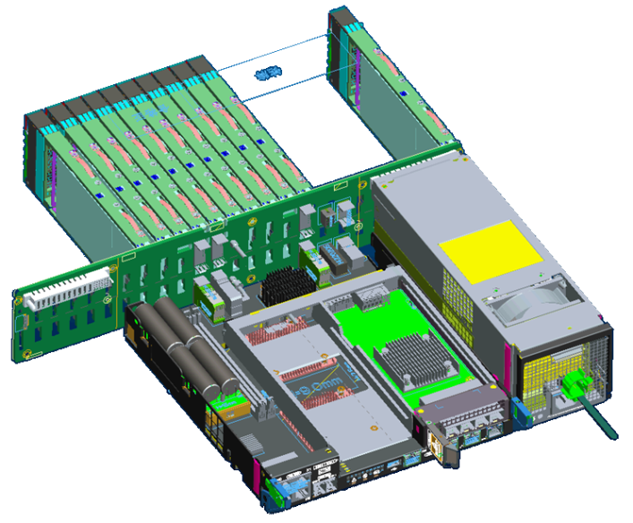
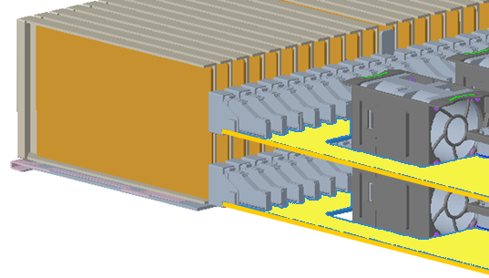
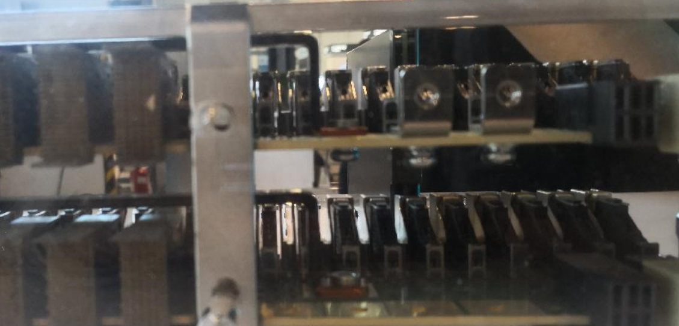
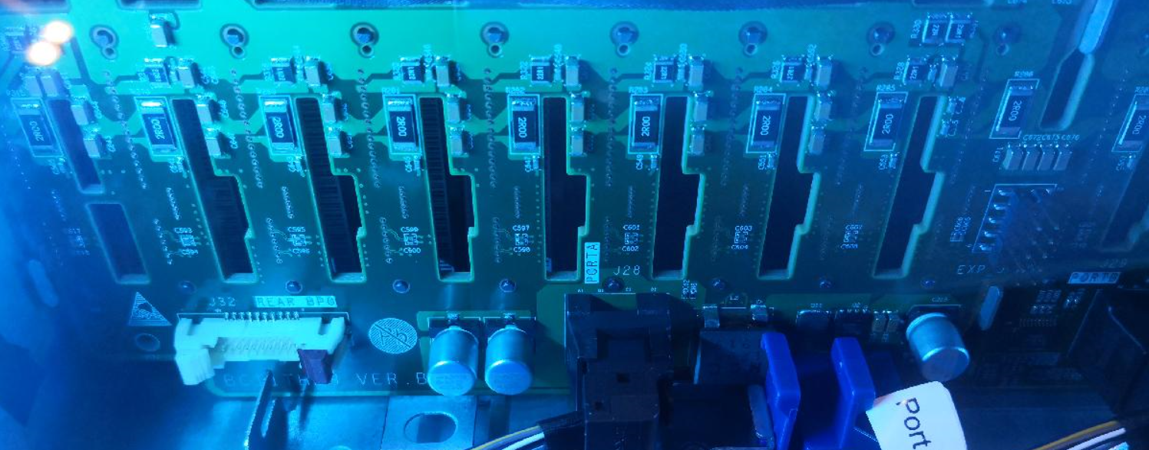
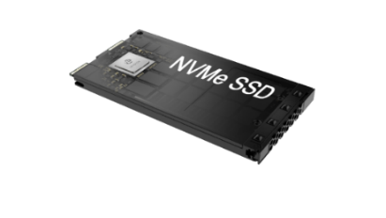
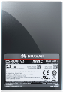
Extremely Reliable
Extreme Performance
Cost Effective
2U, 36 disks, high capacity density
Traditional architecture design
Dual Horizontal Orthogonal Architecture Design
The heat dissipation window is small and the wind resistance is large.
The window area increases by 50%, and the heat dissipation capability increases by 25%.
connection without dual-side interference, increasing the number of hard disks by 44%
PALM
Disk
Double-sided connector, interfering with each other. The number of hard disks is limited.
＞25-disk double-sided connectors cannot be staggered
Horizontal backplane and orthogonal connection
2U integrated equipment, 36 Palm SSDs, 44% SSDs increasing in industry
Traditional
User-defined Palm form
Size：
100.6*14.8*70
Volume：
103cm³
Size：
160*9.5*79.8
Volume：
121cm³
Dual-port Palm SSD
U.2 NVMe SSD
The number of 44% disk slots is added to the width of the 19inch cabinet.
Same capacity, width reduced by 36%
Notes:
Previous slides mentioned the high density design of Dorado V6 SSD and enclosure, this slide shows the custom PALM form factor with orthogonal pins, which boost capacity density by roughly 50% compared to industry traditional design.
Orthogonal – right angled

Slide 10
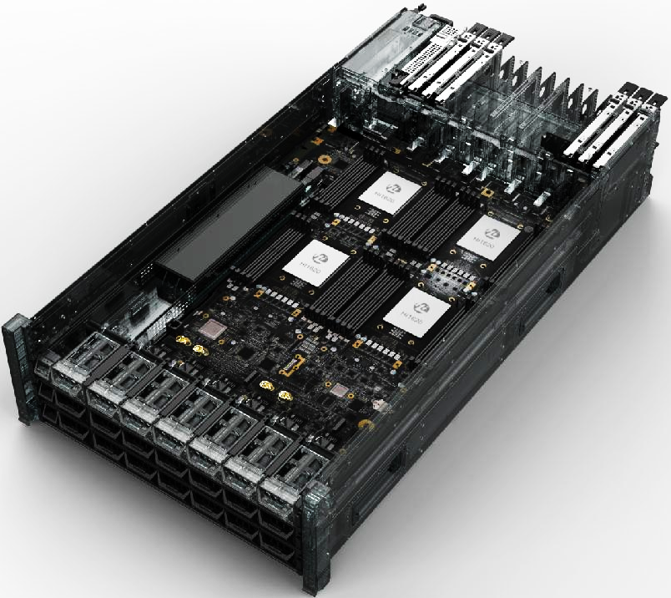
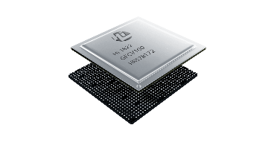

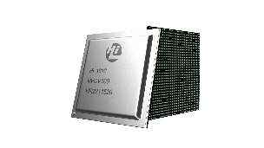

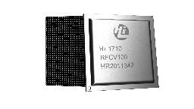
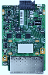
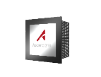
Extremely Reliable
Extreme Performance
Cost Effective
Innovative Hardware Platform with self-developed chipsets
Network Chip Hi1822
lower Network latency 160μs→80μs
Intelligent failover between controllers
Non-disruptive upgrade
CPU Chip Kunpeng 920
NO.1 ARM-Based CPU, 930+ SPECint
Intelligent enclosure, CPU integrated.
SSD Chip Hi1812e
50% lower Latency
20% longer life cycle
BMC Chip Hi1710
90% less fault recovery time (120 min -> 10 min)
AI Chip Ascend 310
AI SoC for mini-scale training
Notes:
OceanStor Dorado's hardware innovation is not only reflected in component design, but also in the fundamental and important field - chip design. Along the I/O path of the Dorado V6 system, Huawei have independently developed five chips to improve the overall competitiveness, including transmission, computing, storage, management, and AI.
These chips, and their tight integration with the storage software stack, is the core reason behind the great performance advantage of Dorado V6. The high throughput, the low latency, the short failover time, can all find some root in this slide. We will see more details in later slides.

Slide 11
Extremely Reliable
Extreme Performance
Cost Effective
Kunpeng 920, the best processor for storage
High concurrency
Up to 48 cores in one CPU
48 Core
High integration
Not only computing
8-Channel
DDR4
100G RoCE
& SAS 3.0
Acceleration Engine
PCIe 4.0
High density
4 Sockets in 1U Space
Notes:
Here is some highlights of the Kunpeng 920 CPU:
Kunpeng 920 has additional capabilities and enhancements beyond the standard ARM spec, including many integrated interface components, co-processors and improved algorithms.

Slide 12
Extremely Reliable
Extreme Performance
Cost Effective
Dorado V6 Design Principle - Distributed, Full-Mesh, and Global Shared Resource
FC/FC-NVMe/NVMe Over Fabric/iSCSI
Distributed Architecture
Consistent Distributed Architecture for High-end/Mid-range/Entry-level series of Dorado V6.
Symmetric Active-Active Cluster(supports symmetric access by the hosts).
Load-balancing between all the controllers and auto-rebalancing upon scale-out, failover and failback.
Shared Frontend
Shared Frontend
Shared Frontend
Shared Frontend
Shared Frontend
Shared Frontend
Shared Frontend
Shared Frontend
Storage Controller
Storage Controller
Storage Controller
Storage Controller
Storage Controller
Storage Controller
Storage Controller
Storage Controller
Shared Backend
Shared Backend
Shared Backend
Shared Backend
Shared Backend
Shared Backend
Shared Backend
Shared Backend
End-to-End NVMe
Front-end: NVMe over FC(32G)/NVMe over Fabrics(RoCE).
Back-end: NVMe SSD/Intelligent DAE.
Controller Enclosure
Controller Enclosure
NVMe Over Fabric (RoCE)
Global Shared Resource
Global cache and global storage pool for all LUNs
High-end series support Shared Frontend module, Shared Backend module(100GE RDMA)
Intelligent DAE
Intelligent DAE
Intelligent DAE
Intelligent DAE
Intelligent DAE
Intelligent DAE
Intelligent DAE
Intelligent DAE
Notes:
Now let's take a step back and look at the high level design principles of OceanStor Dorado V6.
OceanStor Dorado V6 adopts a distributed and full mesh architecture. In the high-end series, it can support a direct-connected architecture of 8 controllers without the need of any switch relays. The controllers use the 100GE RoCE RDMA network to communicate, relying on the RDMA access protocol, greatly reduced CPU and memory load on the I/O path. This significantly improves the efficiency of interactions between controllers.
All controllers form a symmetric Active-Active architecture. Workload can be balanced among all the controllers. It will not make a particular controller become a hot spot and affect performance and reliability, even if there is only one server, one LUN in customer’s IT system.
Highlight High-end: only high end has shared FE, test point
The connection between controllers and disk enclosures also uses IP-based RoCE networks to maximize scalability and reliability. High-end storage can support up to 8 controllers to share disk enclosures, providing unparalleled tolerance for controller failures. This is very unique capability in storage industry.

Slide 13
Hardware
Design
Extreme
Reliable
Extreme
Performance
High
Efficiency

Slide 14

Extremely Reliable
Extreme Performance
Cost Effective
Host IO
Introduction of Connectivity
SmartMatrix Technology over 100GE RDMA
port
port
Every physical port connects all the four controllers in one engine
controller
controller
controller
controller
Shared Front-End
Shared Front-End
Shared Front-End
Shared Front-End
A
B
A
B
A
B
A
B
48
cores
48
cores
48
cores
48
cores
Full Mesh interconnection between all controllers in each engine
Shared interconnection module for connecting between the engines
C
D
C
D
C
D
C
D
48
cores
48
cores
48
cores
48
cores
Shared Back-End
Shared Back-End
48
cores
48
cores
48
cores
48
cores
Shared Back-End
Shared Back-End
Shared Back-End
Shared Back-End
48
cores
48
cores
48
cores
48
cores
One intelligent disk enclosure can be accessed by 8 controllers(2 engines) through the shared back-end module
A
B
A
B
C
D
C
D
Back-End port
Back-End port
Intelligent DAE
Notes:
Dorado support both scale up and out (test point), now let us take a look at how Dorado connect things up internally.
SmartMatrix is a feature of OceanStor Dorado's high-end series, referring a fully mesh connected front end and back end architecture, to achieve extreme scalability and reliability. Again, I’d like to emphasize, this feature is only fully implemented for high end series 8000/18000, lower tiers do not have such high demand and does not offer this fully mesh connected FE/BE.
At the front end, as we saw in earlier hardware design slides, all IO interface modules are shared by all four controllers in each controller enclosure. The shared intelligent FE IO module will automatically distribute work load to controllers, taking care of load balance, fault tolerance automatically without the host being aware of it at all.
In the current version, only the FC protocol has this capability; in the coming Q2 version update, the RoCE protocol will also have this capability.
The controllers are also fully interconnected. There is at least 100Gbps bandwidth between any two controllers, and the link is powered by RDMA for minimal latency.
Similar to the front end, shared intelligent IO cards are also used at the back end to simplify the network connection. Thanks to the flexibility of IP network, Dorado V6 support the sharing of disk enclosures between two controller enclosures, up to eight controllers. This is why Dorado V6 can tolerate 7 out of 8 controller sequential failure, which is far superior to any competitor. We have more detailed coverage on controller failure scenarios in next a few slides.

Slide 15

Extremely Reliable
Extreme Performance
Cost Effective
Intelligent Front-end Connection - No Sense for Controller failover
Controller Enclosure
Server
Shared front end
Shared front end
Shared front end
Shared front end
Controller
Controller
Controller
Controller
Data
Shared back end
Shared back end
Shared back end
Shared back end
FC
Network
The FIMs are linked to servers independently regardless of controller failures.
Controller Enclosure
FIM
FIM
FIM
FIM
Data
Generally, each I/O is directed to a specific storage controller through the backplane.
Data
Back plane
If a controller is faulty, the corresponding I/O is redirected to another normal controller, and the link between the FIM and the server is not interrupted.
Controller
Controller
Controller
Controller
Notes:
Now, let's take a look at the FrontEnd of the SmartMatrix, and how to does Dorado V6 shadow controller failure from I/O host through the shared intelligent front-end interface module.
With the 1822 chip, when any controller failed, the shared intelligent module can sense it in real time, and hold the session of the IO request, and quickly locate another working controller to handle the IO request. The entire process does not require the I/O client to participate, and the host will not receive any NCK or RST. Under normal circumstances, the entire failover action can be completed within 1 second.
Thanks to the shared IO module, the host do not even need to install any multi-path software, or configure it, so it is not only faster, but also easier to deploy and manage.

Slide 16
Extremely Reliable
Extreme Performance
Cost Effective
High availability Architecture(HyperMetro-inner for High-end series)
Tolerance of 2 controllers failure simultaneously
Tolerance of 1 engine failure
Tolerance of 7 controllers failure
Shared Front-End
Shared Front-End
Shared Front-End
Shared Front-End
Shared Front-End
Shared Front-End
A
A’
A’’
A
A’
A’’
A
A’
B’
B
B’’
B’
B
B’’
B’
B
C
C’
C’’
C
C’
C’’
C
C’
D’
D
D’’
D’
D
D’’
D’
D
E’’
E
E’
E’’
E
E’
E
E’
F’’
F’
F
F’’
F’
F
F’
F
G’’
G
G’
G’’
G
G’
G
G’
H’’
H’
H
H’’
H’
H
H’
H
A
B
C
D
E
F
G
H
A
B
C
D
E
F
G
H
A
B
C
D
E
F
G
H
Shared Back-End
Shared Back-End
Shared Back-End
Shared Back-End
Shared Back-End
Shared Back-End
Intelligent
DAE
Intelligent
DAE
Intelligent
DAE
Global Cache supports 3 copies across two engines.
Guarantee at least 1 cache copy available if 2 controllers failed simultaneously.
Only one engine can also tolerate 2 controllers failure at the same time with 3 copies Global Cache
Global Cache supports 3 copies across two engines.
One disk enclosure can be accessed by 8 controllers(2 engines) through the shared back-end module
Guarantee at least 1 cache copy available if one engine failed.
Global cache provides continuous mirroring technology
Tolerates 7 controllers failure one by one of 8 controllers(2 engines)
Notes:
Let us looking at some controller failure scenarios to see how SmartMatrix help.
Since single controller failure can be easily handled by any enterprise storage on the market, we will skip that scenario and directly jump to more complex ones.
Scenario 1: Two controllers fail at the same time
OceanStor Dorado's high-end series has an advanced feature called HyperMetro-Inner. With this feature enabled, there will be 3 copies of data in the cache, which will be distributed to different controllers across two controller enclosures. If any two controllers fail at the same time, at least one copy is still available, and business continuity is not affected.
The probability of two controller hardware failures at the same time may be very low, but after a controller failure, if the administrator replaces the controller too quickly and pulls a wrong controller by mistake, it is equivalent to two controllers failing at the same time, because the new cache mirror pair have not been established. So this scenario actually happens much more frequently than you might think.
Scenario 2: Whole engine (controller enclosure) fails
Whole engine failure is typically due to external reasons such as rack level PDU issue, or water damage etc.
In Dorado V6, when a whole engine fails, on the cache layer, for same reason as the previous scenario, we still have at least one good copy. And on the backend, all disk enclosures can be shared by both engines, so data accessibility is not an issue. That is why Dorado V6 has no I/O interruption during whole engine failure.
Emphasize: survive whole engine failure requires both fully connected Backend shad shared disk enclosures
Scenario 3: Tolerance of 7 controllers’ failure in 8 controllers
When a controller failed, Dorado V6 will generate new cache mirror pair in the remaining controllers after completing the controller switchover. This continuous mirroring solution will tolerate up to seven controller failures in the eight controller clusters, if controllers failed one by one. This is only possible thanks to the fully connected FE and BE design. No other competitor can do this today.

Slide 17
Extremely Reliable
Extreme Performance
Cost Effective
The best Active-Active design
① 3 Copied Cache
② RoCE network
③ Intelligent DAE
Vendor1:
2 Controllers Scale-out
Vendor2:
4~8 Controllers Scale-out
Huawei Dorado V6
IO interface belongs to one controller, controller fails causes link switch over.
IO interface belongs to one controller, controller fails causes link switch over.
Shared front-end, controller failure is transparent to the host
Front-End
Controller
Back-End
Disk enclosure shared with dual-controller, dual-controller(one engine) failure causes service interruption.
Disk enclosure shared with four-controller, 4 controller failure(one engine) causes service interruption.
Global cache provides continuous mirroring technology and 3 copies across 2 engines
Disk enclosure shared with 8 controllers.
No service interruption: any 2 controllers failed at the same time; 1 engine failed; 7 controllers failure one by one of 8 controllers(2 engines)
Notes:
Now, let’s compare Dorado V6’s active-active design with several other mainstream players in enterprise storage industry.
Vendor1 is a relatively traditional architecture. The latest products from most high end enterprise storage vendors still use this architecture. On the front end, each controller has its own IO interface module, and two controllers in the same chassis share a disk enclosure on the back end.
Vendor2’s style design expanded the sharing a little bit in the backend but not in the front. Each controller still has its own IO interface module in the front end, and the four controllers in one engine share disk enclosures in the back end.
Last picture shows Dorado V6’s full mesh in both front and back for comparison.
You can see the left side 2 architecture can not survive many complex failure scenarios we reviewed in previous slide, such as whole engine failure, or even just 2 controllers.
Here are three main reasons why our OceanStor Dorado can provide such high level fault tolerance:
1. Three copies of Cache
2. RoCE network fabric, this is what enabled the fully shared front and back end.
3. Intelligent DAE, with the computing power in intelligent DAE, we have realized the conversion from RoCE to PCIe network.
Again, key message: Tolerance of a full engine failure relies on both shared disk enclosure and fully connected back-end.
Intelligent DAE is not available for low end Dorado V6, same for front end fabric.

Slide 18

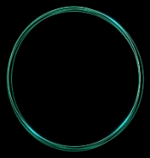
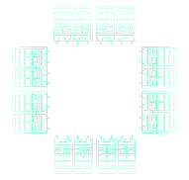
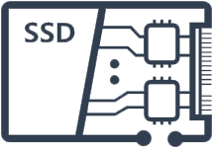


Extremely Reliable
Extreme Performance
Cost Effective
Multi-level reliability technology combination
SmartMatrix
Component reliability
Global disk protection
Reliability first in the industry
Product reliability
RAID-TP
Tolerate 3 disks
at the same time
Architecture reliability
SmartMatrix
Full meshed architecture
Reliability first in the industry
Solution reliability
A-A without gateway
Business continuity, no fault
99.9999% high availability for the most demanding enterprise reliability needs
Notes:
The innovation for reliability in OceanStor Dorado is not only at the controller level, but also at the
component level (such as interface module, SSD etc.),
system level (such as RAID), this covers product and architecture in the graph
solution levels. The effective integration of multiple innovative technologies is dedicated to providing customers with the most reliable storage services.

Slide 19
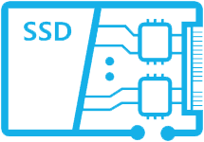
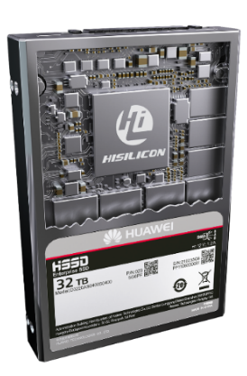
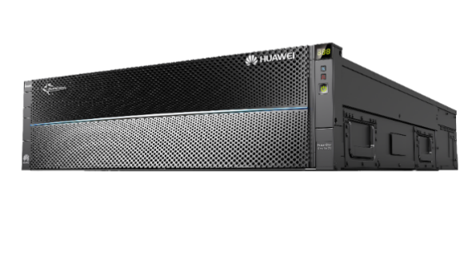
Extremely Reliable
Extreme Performance
Cost Effective
Self-developed SSD disk
Global wear leveling
Huawei's patent: global anti-wear leveling
Storage pool
Storage pool
RAID 4 is supported in SSDs to ensure data reliability
Dorado supports RAID 5/6/TP,
tolerating simultaneous failures of up to three disks
Notes:
Now let us take some deep dive into the component level, first let us look at the core component of Dorado V6, which is the SSD.
OceanStor Dorado V6 SSDs has a controller based on self-developed chip (1812e).
Inside the SSD, we make RAID4 protection across NAND flash chips. This provides some basic fault tolerance by itself. If multiple NAND flash chip failed at the same time, the system will send an alarm signal to the storage system and proactively trigger rebuild to other disks. This is much quicker and more reliable than passive disk failure detection.
At system level, Dorado V6 allow three configurations of RAID: RAID5, RAID6, and RAID-TP, which can tolerate the failure of 1 to 3 SSD devices at the same time. The default level is RAID6.
As we know, NAND flash has a limited number of P/E cycles, so the SSD life have limit. We need to monitor and find ways to extend the life of SSDs. OceanStor Dorado V6 graphically displays the service life of SSDs.
In DeviceManager, the degree of wear and predicted remaining service life for SSDs are displayed, helping customers obtain SSD wear information directly. If the estimated remaining SSD service life is less than two months, the user will be notified in order to prepare spare parts. If the service life is estimated to be less than one month, an about-to-fail alarm will be reported to the user, prompting SSD replacement, and the system will start a pre-copy.
Additional, OceanStor Dorado software includes a few innovative technology to help improve SSD life:
1. Global wear leveling: RAID 2.0+ evenly distributes data to SSDs based on fingerprints to level the SSD wear intensity and improve SSD reliability.
2. Global anti - wear leveling: When multiple SSDs are approaching their wear limits (80%), the system writes more data to some specific SSD to avoid failure of multiple SSDs at the same time, so SSD death are staggered and controlled.

Slide 20
Extremely Reliable
Extreme Performance
Cost Effective
RAID 2.0+
Hot spare
Hot spare
Traditional RAID
LUN virtualization
RAID2.0+ Block virtualization
Data reconstruction speed is improved 20 times
Huawei RAID2.0+: bottom-layer media virtualization + upper-layer resource virtualization for fast data reconstruction and smart resource allocation
Fast data reconstruction: Data reconstruction time is shortened from 5 hours to only 15 minutes. The data reconstruction speed is improved 20-fold. Adverse service impacts and disk failure rates are reduced.
All disks in a storage pool participate in reconstruction, and only service data is reconstructed. The traditional many-to-one reconstruction mode is transformed to the many-to-many fast reconstruction mode.
Notes:
In the previous slide we have mentioned the RAID protection technology. Now we will take a closer look at the RAID 2.0+ implementation in Dorado V6.
The left side shows the well-known traditional RAID implementation technology. Multiple disks form a RAID group. The storage system create LUN space in the RAID group and allocates them to the host. This method has tight inter-dependencies among disks within the RG, any modification suffers major write amplification, performance is limited by width of RG, and rebuild is very slow.
Middle picture shows a second RAID architecture based on LUN virtualization technology. The composition of a RAID group is no difference from the traditional RAID technology. The main optimization is in how to allocate LUN resources. The storage system divides the capacity of the RAID group into small storage shards, puts them in a large virtual resource pool, and then allocates LUNs to hosts by combining small storage shards from the virtual resource pool. LUN virtualization technology can solve the storage performance problem very well. Even a small-capacity LUN can also leverage disks’ processing capabilities of all RAID groups involved in the storage pool. At the same time, it can allocate larger LUNs than RAID group’s capacity to the application system. Although the performance problem is solved, there are still risks about reliability. After any disk fails, only the disks in the RAID group can participate in data reconstruction, and data can only be written to the designated hot spare disk. At present, the high-end storage of NetApp, EMC, Hitachi, and IBM still use this RAID implementation technology.
Finally, there is the RAID 2.0+ block virtualization technology used in OceanStor Dorado V6. Unlike previous technologies, this RAID technology is an end-to-end disk virtualization technology. At the lowest level, the physical disk is divided into small storage shards. The storage shards that make up the RAID group or EC Group (we call it CKG) are no longer specific disks, but random shards from any disk in a storage pool. The upper-layer technology is similar to the LUN virtualization technology.
Similar to LUN virtualization technology, this RAID technology can bring good performance benefits; at the same time, it can also bring greater advantages in reliability. When one of the disks fails, because the virtual CKG related to it will involve all the disks in the resource pool, more disks will be involved in the data rebuilding. In addition, no special hot spare disk is set up and the reconstructed data are distributed to all surviving disks at the same time. This turned the rebuilding tasks from serial to parallel operation. The performance of data reconstruction is greatly improved by about 20 times. This means that the risk of data loss is greatly reduced. Currently, only Huawei and HPE mainly use this RAID technology for high-end storage.
These benefits are not free, the biggest change is the increase in metadata management and the amount of computing. It places higher requirements on the computing capacity of the storage system and the design capability of the RAID (EC) algorithm. This is exactly Huawei’s advantages, because Huawei has self-developed computing chips and a unique high efficiency EC algorithm.

Slide 21
Dynamic Data Reconstruction
Extremely Reliable
Extreme Performance
Cost Effective
N+M
(N-1)+M
Disk 0
Disk 1
Disk 2
Disk 3
Disk 4
Disk 0
Disk 4
Disk 5
Disk 6
T0
D0
D1
D2
D3
P
Q
T1
D0
T2
D0’
D1’
D2’
P’
Q’
Notes:
Now, let's look at another interesting technology related to RAID, Dynamic Data Reconstruction.
A RAID group has N+M members (N indicates data columns and M indicates parity columns).
In OceanStor Dorado, we do not configure dedicated hot spare disks, but only reserve a certain amount of hot spare space for data reconstruction. Let's take a look at how the system handles a disk failure.
Assume that there are 7 disks in the disk cabinet, and 4 + 2 EC technology is used. As shown in the figure, in a CKG, D0 ~ D3 are data slices, and P and Q are parity slices.
When Disk 0 fails, because there are extra disks, the data slice D0 on Disk 0 can be recovered in Disk 6 during data reconstruction. So, the RAID level remains N+M.
After the data reconstruction is complete, another Disk 4 fails. What will happen? Now we no longer have enough space to rebuild, there are two options left:
Option A: Reduce M and reconfigure EC as 4+1, the advantage is user capacity is not affected, but reliability is compromised.
Option B: Reduce N and reconfigure EC as 3+2, the benefit and disadvantage is exactly opposite of above.
OceanStor Dorado chose Option B to reduce the number of columns in the data slice to ensure that the reliability of the data is not degraded.

Slide 22

Extremely Reliable
Extreme Performance
Cost Effective
Offload data reconstruction to Intelligent disk enclosures
Controller
Controller
3. Reconstruct data is written into hot spare space.
5 Data reconstruction using P’ Q’ P” and Q”. Then data is written into hot spare space..
Read Disk
Calculation Verify
1.1 Reconstruction
1.2 Reconstruction
DAE A
DAE B
Intelligent DAE A
Intelligent DAE B
4.1 Transmits P’ and Q ‘
4.1Transmits P” and Q”
1. Read data from disk
2. Obtain 23 pieces of data
Read
Disk
Calculation
verify
Read
Disk
Calculation
verify
…
…
2.1 Read data from disk
3.1 Obtain 12 pieces of data
3.2 Obtain 11 pieces of data
2.2 Read data from disk
Chunk
Chunk
Chunk
Chunk
Chunk
Chunk
Chunk
Chunk
Intelligent Offload
Chunk
Chunk
…
Chunk
Chunk
…
Chunk
Chunk
Chunk
Chunk
SSD
SSD
SSD
SSD
SSD
SSD
SSD
SSD
SSD
SSD
SSD
SSD
SSD
SSD
SSD
SSD
The reconstruction bandwidth of a single disk in the 23+2 RAID group is reduced from 24 times to 5 times
Notes:
This slide introduce what benefits are brought to Dorado V6 by intelligent DAE.
First let us look at the data reconstruction process in the traditional mode. The data reconstruction operation of the data is completed by the controller. The controller sends a data read instruction to the disk where all the remaining members of the CKG are located, reads the data to the controller, calculates the data to be reconstructed, and writes the reconstructed data to the SSD.
When we use intelligent DAE, most of the data reconstruction work will be offloaded to the DAE's CPU for processing. The controller sends instructions to the DAE. The DAE reads the data from the remaining disk nodes and calculates the parity data, and then sends the parity data to the controller. If multiple DAEs are involved, the controller calculate new parity data base on parity data received from the DAEs. Then write the parity data to the SSD.
Next we look at the IO bandwidth related to the controller.
After the data reconstruction service is offloaded to intelligent disk enclosure, the reconstruction bandwidth is reduced from 24 times to 5 times, and the impact of reconstruction on host service performance is <5% :
1）带业务重构带宽从80MB提升200MB，重构业务卸载到智能框上降低控制器CPU消耗；
2）不带业务重构，其瓶颈是到框的链路，重构业务卸载到智能框上减少链路消耗；

Slide 23


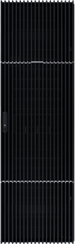
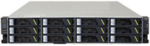
Extremely Reliable
Extreme Performance
Cost Effective
Comprehensive HA/DR Solutions
HyperMetro
Gateway-free, Active-Active, Static + Dynamic Quorum
Smooth upgrade to 3DC
Site A
Site B
Synchronous
HyperMetro
Asynchronous
WAN
Oracle RAC
VMware Vsphere
Fusionsphere
Cluster
...
A
B
Asynchronous
A
WAN
B
Asynchronous
WAN
WAN
C
C
FC/IP
Network
WAN
FC/IP
Network
Serial
Synchronous
HyperMetro
Asynchronous
WAN
WAN
Synchronous Mirroring
A
B
A
B
Asynchronous
Asynchronous
WAN
WAN
WAN
WAN
C
C
IP
Network
IP
Network
Parallel
Production Storage
Production Storage
Synchronous
HyperMetro
Synchronous
HyperMetro
Site C
A
B
Asynchronous
Standby
A
B
Asynchronous
Asynchronous
WAN
Asynchronous
Standby
WAN
WAN
WAN
WAN
WAN
Quorum Server
C
C
Ring
Notes:
HyperMetro is a solution-level active-active technology provided by OceanStor Dorado V6. This technology enables two storage systems to work in active-active mode in the same site, or in any two sites within 100 km of each other.
HyperMetro supports both Fibre Channel and IP networking (10GE). It allows two LUNs from separate storage arrays to maintain real-time data consistency and to be simultaneously accessible to hosts.
If one site fails, hosts will automatically failover to the other site. The arbitration mechanism (quorum server) can be deployed at a third site.
The HyperMetro solution does not require any gateway, and it can supports both static quorum mode and dynamic quorum mode based on quorum server, and can automatically switch according to the scenario, which can tolerate more failure scenarios.
HyperMetro solution is also integrated with HyperReplication, which allows the 2DC solution smoothly upgrade to a 3DC solution like shown on right side. HyperMetro can be used to implement data active-active for local data service, with remote DR through HyperReplication. In terms of 3DC topology selection, in addition to conventional serial and parallel solutions, OceanStor Dorado also provides a ring topology capability. When one site fails, the asynchronous data replication site can continue through the other remote DR link.
Here are a few key advantage of Huawei HyperMetro solution compared with competitors: (test points)
Gateway free
Online upgrade from 1 DC -> dual DC
Online upgrade from hyper metro to 3DC

Slide 24
Extremely Reliable
Extreme Performance
Cost Effective
Efficient data protection based on RoW
Source
Creating a Clone Using a Read-Only Snapshot
①
Clone from read-only snapshot
HyperClone_1
TP0
HyperCDP_0
HyperClone_2
②
Freely Snapshot rollback
TP1
HyperSnap_0
TP0
HyperSnap_1
TP1
Cross-level rollback
Mixed cascading snapshot and clone
TP0
HyperSnap_2
③
TP2
Cascading snapshot
TP1
HyperClone_3
TP2
TP2
TP0
HyperSnap_4
Remarks:
TP1
HyperClone_4
TP0, TP1, and TP2 are examples. Snapshot and clone can be associated with any time point of the source LUN.
Cascading clone
HyperCDP – Data Protection
HyperSnap – Read & Write
HyperClone – Data Mirror
Notes:
Now let us take a look all kinds of data protection mechanisms offered by Dorado V6.
OceanStor Dorado provides a variety of data protection solutions.
HyperCDP is mainly used for historical data recovery
HyperSnap is a readable and writable snapshot, and some vendors also call it data clones, which can be used for reporting, testing, and data compliance auditing.
HyperClone creates a real-time Data mirror.
All these technologies are built on RoW (Redirect on Write) technology, and we can combine them arbitrarily to meet the data protection needs of various complex business scenarios. RoW is a key differentiator that enabled lossless performance of Dorado V6 enterprise features.
Test point: HyperReplication use ROW to ensure lossless performance
If someone ask you what enabled lossless performance of HyperCDP, or HyperReplication, or HyperSnap, the answer is RoW
DCL = Differential Change Log, this is the foundation of all these features.
Test point:
CDP = Continuous Data Protection (read only)
HyperSnap is r/w

Slide 25
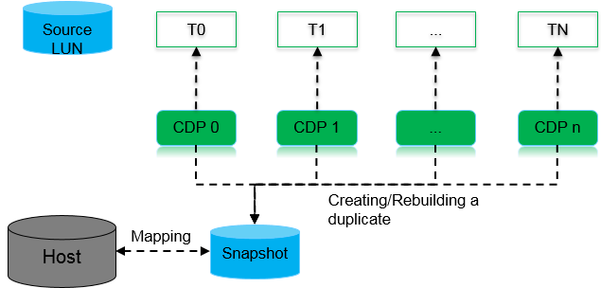
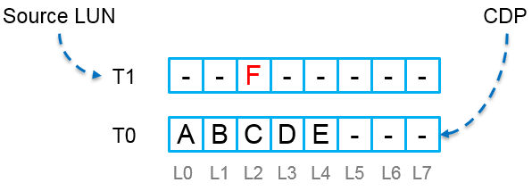
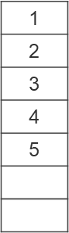
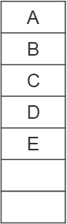
HyperCDP - 60,000 protection points, once every 3 seconds
Extremely Reliable
Extreme Performance
Cost Effective
COW
ROW
Mapping table
Data space
Mapping table
Data space
1
2
3
4
5
A
B
C
D
E
F
F
B
3
Add the old data block into the list of blocks to be released.
2
Write new data at the original location.
B
2
B
Modify the LUN mapping table and other metadata.
F
1
Write new data into a new physical location.
1
Copy data from the original location to the new location.
1 read, 2 writes, and 1 metadata update
1 write and 1 metadata update
Notes:
Now let us take a look at some technical specs of HyperCDP, and how RoW works.
We know that for general high-end storage, each LUN can take no more than 1,000 snapshots totally, and the interval is about some minutes. OceanStor Dorado can support up to 60,000 snapshot-based data protection points, with a frequency of up to 3 seconds. How was this achieved?
The magic comes from RoW technology. As shown in the figure on the right, the source LUN and CDP are only mappings to the data storage space. To create a new CDP data protection point, the system just needs to create a new mapping table. The main pressure lies in the management metadata, and does not involve real data operation.
In the CoW model, when you need to update a piece of data, you need to migrate the original data to a new place, and then write the new data to the original location, so it is called Copy on Write.
In the RoW model, new data is written directly into the new space, and the user's data update requirements are realized by updating the metadata mapping table. The old data in the original location is reserved for snapshot usage or recycled.
Compare the number of I/O operations at bottom of the diagram, you can see RoW is much more efficient. This is the key enabler of HyperCDP’s 3 seconds short activation interval, and huge 60k protection point spec.
Compare to competitors based on CoW technology’s minutes interval and 1k limit.
Test point: 3 seconds activation time

Slide 26
Extremely Reliable
Extreme Performance
Cost Effective
Non-Disruptive Upgrading (NDU)
No business impact, no performance loss
94% components in user mode, upgrading in 1s, no host connection loss by switching on global sharing frontend card
6% components in steady kernel, upgrading with rebooting in minutes
1
second
Service
Service
Service
Service
Service
Protocol
Data
Control
Manage
-ment
Inter
Communi
-cation
Stable OS Kernel
Notes:
The new generation of OceanStor Dorado storage adopts a modular design. More than 90% of the modules will only be in user mode, which means that the upgrade of these modules does not need to restart the operating system and can be completed quickly online, usually within only 1 second. Combined with the front-end intelligent IO module, the system upgrade can be achieved without impacting the business application. This capability is supported by all series, not just high-end series.
For a small number of kernel-mode module upgrades, including the upgrade of the controller’s operating system, if it is a high-end storage, rolling upgrade can also minimize business impact. Before the controller is upgraded and restarted, it will proactively notify the shared front-end intelligent module to quickly switchover subsequent IO requests to the controller that is still working normally.
This great NDU support was not available in older generation like V3, so this is a major improvement.

Slide 27

Extremely Reliable
Extreme Performance
Cost Effective
Online upgrading without business disruption
Host I/O
HiSilicon SmartIO Front-end interface
Hi1822
I/O
System Management process
Device Management process
System Management process
Device Management process
IO Processing process
IO Processing process
Configuration Management process
UI/CLIUI/CLI Management process
Configuration Management process
UI/CLIUI/CLI Management process
① User mode upgrading, no system reboot
② Self-designed Chips hold IOs and maintain host link information
③ IO Processing Process upgrading
④ Host IO recovers
Self-designed chips hold IOs and keep links alive.
IO Processing process upgrading period less than <1S
Host link keeps online during upgrading
Support single link Firmware upgrading
Modular software architecture design, upgrading of component in 1S
Notes:
Now, let’s review how OceanStor Dorado can complete the system upgrade without affecting the business applications.
First, we upgrade components not in key IO path, such as system management modules, of course, it can be done without affecting the business.
Next, we quiesce the user's IO request on the front-end intelligent module.
After the IO request is frozen, we quickly upgrade the program modules in the IO key path, which can usually be completed within 1 second.
After the key path component upgrade is completed, the front-end intelligent module releases frozen user IO requests.
During the entire upgrade process, the host will not lose established storage connection, and would only notice a 1 second I/O slowdown.

Slide 28

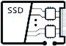

Extremely Reliable
Extreme Performance
Cost Effective
Summary: Multi-level reliability technology combination
99.9999%
system level reliability
HyperMetro: Gateway-free active-active solution (1 ms latency)
FlashEver without data migration
HyperCDP, HyperSnap, HyperClone, HyperReplication, 3DC
Solution
RAID-TP: Tolerance for simultaneous failure of 3 disks
RAID 2.0+, Dynamic Reconstruction
End to End DIF
Intelligent DAE
Non-Disruptive Upgrade
99.99999%
solution level reliability
System
Ever Solid
Architecture
SmartMatrix fully-interconnected architecture
tolerates failure of 7 out of 8 controllers
Global wear leveling
Huawei-patented global anti-wear leveling
Intelligent IO Module
Built-in dynamic RAID utilizes space
Component
24
Huawei Confidential
Notes:
The new generation of OceanStor Dorado V6 products guarantees the reliability of storage services through a multi-level and large number of innovative technologies, and provides our customers with up to seven 9-level storage reliability. There are many technologies involved in the field of reliability design. Because the time limit, we can only introduce the key highlights today. There are more documents and details on Huawei's official website, such as the technical white paper.

Slide 29
Hardware
Design
Extreme
Reliable
Extreme
Performance
High
Efficiency

Slide 30

Extremely Reliable
Extreme Performance
Cost Effective
End-to-End Symmetric Architecture
Symmetric interface
All series Support Active-Active access mode of the hosts, requests can evenly distribute on every frontend link
LUNs of all series have no ownership controller, easy for use and load balance(LUNs are divided into slices and slices are distributed evenly on all the alive controllers by using DHT algorithm)
High-end series provide shared and intelligent frontend IO module which can divide LUNs into slices and send the requests to their target controller for reducing latency
Host
SAN
Hash sharding
DHT
Global Cache
IOs(located in one or more slices) of LUNs can be written to the cache of all the controllers and then be responded to the host
The intelligent read cache of all the controllers can pre-fetch all the LUNs’ data and meta data for cache hitting
Global cache
Global Pool
…
…
Storage pool can spread across all the controllers and use all the SSDs connected to the controllers to store all the LUNs’ data and meta data by RAID2.0+
Notes:
Dorado V6 features end to end symmetric architecture, which can be viewed from 3 layers, (right side of chart)
Test point: only high end series has shared front-end
Highlight “Highend series” in first section bullet #3
On top of this great architecture, Dorado V6 also offers user a rich set of QoS controls in following aspects:
LUN priority
Max bandwidth
Max IOPS
Latency control

Slide 31
Extremely Reliable
Extreme Performance
Cost Effective
FLASHLINK®: Intelligent Algorithm for Dynamic CPU Resource Scheduling
LUN
Controller enclosure
CPU
Core groups
A LUN is divided into multiple slices (also called shards). Each slice is mapped to specific CPUs in the storage controller for I/O processing
CPU Core Grouping
The CPU cores are divided into multiple groups, and each group is assigned a specific job
Dynamic Priority Scheduling
High-priority jobs obtain more cores from the shared CPU core groups
Service Load Isolation
Each CPU core only processes its own I/O requests to avoid mutual lock
…
Storage controller
Core
Core
Core
Data exchange
I/O Read
#1
Slice #10
Slice #9
Core
Core
Slice #8
Storage controller
Core
Core
Core
Slice #7
I/O read/write
I/O Read
#2
Slice #6
Core
Core
Slice #5
Storage controller
Core
Core
Core
Slice #4
Data update
I/O Write
#1
……
Slice #3
Core
Core
Slice #2
Storage controller
Core
Core
Core
Slice #1
Data reduction
I/O Write
#2
Slice #0
Core
Core
Notes:
FlashLink is Huawei’s brand name for a series of intelligent chipsets used in the Dorado V6 system. Here on this slide we will dive into some details of the CPU chip, and how the software stack is optimized for it.
First let us look at the storage LUN to CPU core mapping mechanism: (read right side top 3, then say last is a result)

Slide 32


How does Distributed Architecture work
Extremely Reliable
Extreme Performance
Cost Effective
Native multipath
Active-Active access : round-robin etc.
Huawei ultrapath Embedded router map Divides into slices
distributes IOs to target controller
Native multipath
Active-Active access : round-robin etc.
Host
Host
Host
SAN
SAN
Shared Front End
Embedded router map
Divides into slices
distributes IOs to target controller
SAN
Front End IO Module
Front End IO Module
Front End IO Module
Front End IO Module
Front End IO Module
Front End IO Module
Multi processor
dynamic resource allocation
Multi processor
dynamic resource allocation
Multi processor
dynamic resource allocation
CPU
CPU
CPU
CPU
CPU
CPU
CPU
CPU
CPU
CPU
CPU
CPU
DHT
DHT
DHT
Global cache
Global cache
Global cache
…
…
…
Global Pool: RAID2.0+, Flashlink 2.0
Global Pool: RAID2.0+, Flashlink 2.0
Global Pool: RAID2.0+, Flashlink 2.0
Mid-range/entry-level with native multipath
Mid-range/entry-level with ultrapath
High-end with native multipath
Notes:
Another key design behind Dorado V6’s high performance is rooted in the distributed architecture. Now let us take a closer look at how this distributed architecture works to handle a host I/O.
First of all, at the front end where the I/O requests arrive. Dorado V6 supports Active-Active access, requests can evenly distribute on all frontend link
With traditional multipath, front end IO modules receive random IOs and transfer them to its owner controller. This controller will distribute IOs on local and peer controller by DHT algorithm for load-balance. The one transferred to peer controller has additional latency(about 50us)
With Dorado V6 mid-range/entry-level series, Huawei provide ultrapath software to customers to avoid this additional transfer latency.
For high-end series, the intelligent and shared front end IO module can decide the target controller by itself, so that the additional transfer latency is necessary

Slide 33

Extremely Reliable
Extreme Performance
Cost Effective
Performance Express Supported by E2E NVMe and RoCE
read
HOST
write
Self-developed ASIC interface module:
Offload the FCP and NoF protocol stacks
Higher rate 32Gbps(FC)/100Gbps(ETH)
The chip responds to the host directly, reducing the number of I/O interactions.
ASIC IO balancing/distribution
Multi-queue and polling, lock-free.
32G/FC 100G/RoCE
Shared Frontend
Shared Frontend
Shared Frontend
Shared Frontend
50us
30us
Storage Controller
Storage Controller
Storage Controller
Storage Controller
Self-developed ASIC SSD disk/enclosure:
Read priority technology: Read requests on SSDs are preferentially executed to respond to hosts in a timely manner.
The intelligent disk enclosure is equipped with the CPU, memory, and hardware acceleration engine. Data is reconstructed and unloaded to the intelligent disk enclosure to reduce latency.
Multi-queue and polling, lock-free.
Storage
Engine
Shared Backend
Shared Backend
Shared Backend
Shared Backend
100us
100G/RoCE
Intelligent DAE
Intelligent DAE
Intelligent DAE
Intelligent DAE
Notes:
Another key high performance design of Dorado V6 is E2E NVME with RoCE RDMA network serving internal communications. This is transparently handled by some Huawei proprietary hardware shown in this slide. (read right side chips)
Mention SPC-1 benchmark of 105us, and the math

Slide 34
Extremely Reliable
Extreme Performance
Cost Effective
Nearly all software components are in user-mode
Reducing latency caused by interactions between kernel-state and user-mode
Traditional design
less user-level components, more interaction
Dorado V6
full user mode, less interaction
User space
OMM
Space Mgmt.
Value-added features
User space
OMM
Space Mgmt.
Value-added features
NVMe Diver
Disk Mgmt.
Pool Mgmt.
Kernel space
Driver
Disk Mgmt.
Pool Mgmt.
Kernel space
SAS Diver
Call each other between user mode and kernel mode
High Latency
Reduce interactions between two modes
Low Latency
Notes:
This slide explains how Dorado V6 optimized the software stack to push low latency to the extreme.
In the high-end enterprise storage industry, major vendors are pushing latency to sub-ms level, i.e a few hundred micro-seconds.
We all know context switching between user and kernel space is expensive, but not sure how many of you have a idea of how much a context switch cost. On a typical commercial x86 hardware and Linux OS, one context switch can cost up to 10us.
On the left side of this slide, you can see a traditional storage stack involves many iterations of context switching and memory copy in order to serve one I/O.
On the right side, you can see Dorado V6 optimized the stack to consolidate context switches down to only 1, by implementing majority of business logic in user space.
This design alone will save tens of us latency from each and every I/O request, and also reduce a lot of other related resources such as memory copy and CPU.

Slide 35
Extremely Reliable
Extreme Performance
Cost Effective
Intelligent NIC optimization: Traditional NIC -> TOE -> DTOE
Traditional NIC
TOE
TCP offload engine
DTOE
Direct TCP offload engine
I/O
I/O
I/O
PHY
PHY
PHY
MAC
MAC
NIC
MAC
TOE NIC
IP
DTOE NIC
IP
TCP
TCP
buffer
Driver
buffer
buffer
Socket
IP
Kernel space
Kernel space
TCP
Driver
OS
Driver
OS
Socket
Socket
OS
DIF
App
User space
DIF
App
User space
DIF
App
User space
Challenge:
A traditional network card needs to trigger an interruption for processing each data packet, and CPU resource consumption is severe.
Advantage:
Each application can finish a complete data processing process before triggering an interrupt, significantly reducing the server's response to the interruption.
Challenge:
There are still high latency overheads such as kernel mode interrupts, locks, system calls, and thread switching.
Advantage:
Move processing of the transport layer to the Huawei customized network card 1822's microcode
Optimize storage application software to adapt the new architecture
Implement data (from the link layer) directly to the application memory
Bypassing the kernel state, significantly reducing the latency
Notes:
This picture explains the benefit of Huawei smart NIC’s DTOE benefit, based on Huawei 1822 chipset.
(walk through 3 types)
Test point: 100GE ROCE RDMA network is what we use for scale out and smart DAE

Slide 36
Extremely Reliable
Extreme Performance
Cost Effective
FlashLink®: Intelligent Disk Enclosure & Collaboration of Chipsets
System Controller
System Controller Chips
FEI
FEI
Data read/write
Cache flushing
Advanced features
前端接口
前端接口
Intelligent DAE
PCIE
PCIE
*Garbage collection
*Compression
Data reconstruction
DIMM
DIMM
DIMM
DIMM
CPU
CPU
Offloading
CPU
CPU
Offloading workloads from controllers to Intelligent DAEs.
Improve system performance by 30%.
Improve reconstruction speed by 100%
Lower performance impact of reconstruction on business from 15% to 5%
CPU
CPU
RoCE
Intelligent DAE Chips
CPU
CPU
DIMM
DIMM
DIMM
DIMM
PCIE
Proprietary SSD Chips
Notes:
Almost all storage system prioritize the tasks in order to ensure user experience. Tasks related to user IO requests have the highest priority. Background tasks such as data reconstruction are usually performed at a relatively low priority to reduce the impact on storage performance.
This brings a huge challenge of reliability. When a disk node fails, data recovery process can be very slow, especially during busy business hours, which will bring a great risk of data loss.
Today’s storage system capacity is normally very large, easily in tens of TB or even PB level. Rebuild data for a failed disk can take a long time especially during busy hours. System running in degraded mode has much higher risk for secondary failure or even 3rd, leading to data loss.
OceanStor Dorado V6’s intelligent DAE has its own CPU and memory resources, which can offload most data reconstruction tasks from the controller, no longer competing with host I/O for controller CPU cycle and bandwidth, and at the same time ensure that data reconstruct as quickly as possible. We compared the latest V6 version with the previous V3 version and found that under heavy load, data reconstruction speed can be increased by 150%.

Slide 37
Extremely Reliable
Extreme Performance
Cost Effective
FlashLink®: Smooth GC with Multi-stream to reduce WA by 60%
Array
Array
Normal
Multi-Stream
Standard
Multi- Stream
Full Block Reclaim
No Garbage movement
Physical Block
Hot Data
Deleted Data
Cold Data
Write Amplification reduces over 60%, life cycle expands 2 times
Notes:
You might have heard multi-stream ssd, the multi-steam on this slide is not to be confused with that. Explain both
Dorado V6’s multi-stream design is a data classification feature, combined with the block level virtualization, we can group blocks that needs update together, hence greatly reduce the amount of physical media chunks that has to be touched per update, or in other words - reduce write amplification.
Multi-stream:
Less write amp
Longer SSD life
Less garbage collection

Slide 38
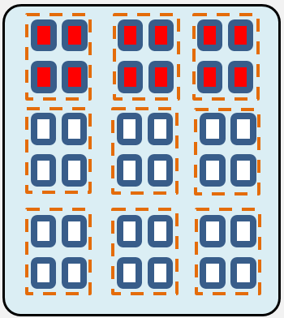
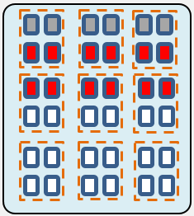





Extremely Reliable
Extreme Performance
Cost Effective
FlashLink®: Smooth GC with Multi-stream (cont.)
Hot block list
Metadata is changed frequently, so metadata flows are assigned to the same block list to reduce the amount of data moved during GC and improve GC efficiency.
ROW
ROW
TRIM
Metadata
Warm block list
User data is changed less frequently, and user data flows are also assigned to the same block list. Data to be moved can then be located sooner during GC and GC efficiency can be improved.
User data
ROW
TRIM
Cold block list
Global GC
User data that has remained unchanged for a long time is also less likely to be changed in the future. Such data flows are assigned to the same block list as well so that fewer blocks need to be scanned during GC and GC efficiency can be improved.
Notes:
Key design - group data into chunks/blocks based on their update frequency, so GC can run much more efficiently.
- Intelligent adjust GC levels based on garbage percentage and CPU usage
GC I/O yield to host and metadata
Global GC triggers TRIM

Slide 39
Extremely Reliable
Extreme Performance
Cost Effective
Global Cache with RDMA & WAL
Write Latency
LUN0
LUN1
LUN2
……
……
……
95us
4K
4K
8K
4K
4K
8K
4K
4K
8K
50us
Write Ahead Log
Cache Linear space
A
B
C
D
E
……
Traditional Cache
Dorado V6
Data Write
A B C
D E
……
Global memory virtual address space
AddrN1
AddrN2
AddrN3
Controller-A Memory
Controller-B Memory
Controller-C Memory
Controller-D Memory
Notes:
WAL = Write Ahead Log
On an OceanStor Dorado V6, caches of all controllers constitute a global cache. Data on each LUN is evenly distributed to the caches of all controllers and processed by them. In this way, LUNs do not have any ownership.
This slide shows the write processes on an 4-controller Dorado V6, the overall effect is, global cache layer is responsible for managing all cache memory resources across multiple controllers and form a virtual linear space for host I/O caching needs, and meanwhile maintain redundancy and reliability of data.
There are more detailed step by step explanation in Dorado V6 technical white paper in case anyone is interested.

Slide 40

Extreme Reliable
Extreme Performance
High Efficiency
Full stripe writing in RoW
Same performance across different RAID levels
LUN0
LUN1
LUN2
KIOPS
...
...
4 KB
...
Logic space
4 KB
3 KB
7 KB
4 KB
3 KB
7 KB
4 KB
16 KB
ROW and I/O aggregation
Log structure
A
B
C
D
E
...
Data
update
Dorado
A
B
C
D
E
Full stripe
P
Q
CKG
Traditional Way |  |  |  |  | Dorado way
Configuration | Extra Reads | Extra Writes | Total IOs (extra IO) |  | Configuration | Extra Reads | Extra Writes | Total IOs
RAID-5 | 2 | 1 | 4 (3) |  | RAID-5 | 0 | 0 | 1
RAID-6 | 3 | 2 | 6 (5) |  | RAID-6 | 0 | 0 | 1
RAID-TP | 4 | 3 | 8 (7) |  | RAID-TP | 0 | 0 | 1
Traditional Array
Notes:
In Dorado V6, small and random writes are aggregated into a big CKG and flushed down to media as a full stripe write, combined with ROW technology, there is no extra read/write/chunk reconstruct during data update, regardless of the RAID type.
In the bottom left corner table, you can see number of I/O required to perform one small update using traditional design vs Dorado design. (read the counts 4,6,8 vs 1,1,1)
This is why Dorado has a linear and higher performance than traditional design.

Slide 41
Hardware
Design
Extreme
Reliable
Extreme
Performance
High
Efficiency

Slide 42
Extremely Reliable
Extreme Performance
Cost Effective
Deduplication and compression: inline, Background, Fixed length, Variable length
Data Write
1
Pattern matching in Cache, keep hot fingerprint in memory cache, increase reduction rate and performance
1
Pattern recognition
Local hot Fingerprint table
Fingerprint table
2
Simultaneous calculation of similar fingerprint (SFP) and weak HASH fingerprint (FP)
2
Fingerprint calculation
5
Find the hot fingerprint table, if can hit the fingerprint table, do online deduplication and return fingerprint reference counting
opportunity table
3
Check Local fingerprint table
4
adaptively select the online compression algorithm according to the load situation.
Match?
No: new data
6
Background fixed-length or similar deduplication
5
Save fingerprint information to the opportunity table
3
4
Inline deduplication Return fingerprint
Compression
& Compaction
When the SFP is the same, the background deduplication operation is implemented. If the fingerprints are the same, the background fixed length deduplication process is executed, otherwise, the background variable length deduplication process is executed.
6
Update physical address
Notes:
Dorado V6 support both inline and post-dedup (background dedup), this is already leading the industry. By default system will intelligently choose what to use. (called smart dedup, which is the default setting, test point)
On top of this, it also support both fixed length and variable length, as well as similar dedup. The combination of all these feature makes Dorado V6 an absolute front runner in the industry.
While offering such a rich function set, Dorado V6 was able to maintain sub-millisecond latency when performing all these.
From the flow chart on this slide, you can see how write data flow through a few steps to perform conditional inline or background dedup, with the help of opportunity table to increase efficiency, and go through compaction and compression.

Slide 43

Extremely Reliable
Extreme Performance
Cost Effective
Similar Deduplication VS Variable/Fixed length Deduplication
Data reduction effect:
50% increase, compared to fixed length deduplication
30% increase, compared to variable length deduplication
512B
VS
64B
Scenario
Description
Fixed
Variable
Similar
Exactly the same
Partially identical,
sector offset
Partially identical,
bytes offset
Partially identical,
anywhere different
Notes:
Now let us take a quick look at the benefit of similar dedup, we will see more details in next slide

Slide 44


Extremely Reliable
Extreme Performance
Cost Effective
The principle of similar deduplication
Similar Fingerprint（SFP）
Variable length deduplication is mainly achieved by relying on similar fingerprints (SFP). For a set of data, although not identical, but with similar data, a similar fingerprint (SFP) can be calculated for these data. Calculate multiple similar fingerprints for the same data section.
Step 1: Calculate the SFP for the original and find the data for the same SFP.
Step 2: Put similar data together, select a reference block, and find difference parts for other data.
Calculate
Data #1 is selected as a reference block
1-4’s SFPs are SFP1, can be put together for variable length deduplication
Calculate
Mark difference parts on data #2~#4
Calculate
Calculate
Calculate
Step 3: Put similar data together, select a reference block, and difference parts for other data.
Notes:
This slides explains how similar dedup works. –read text on slide

Slide 45















Extremely Reliable
Extreme Performance
Cost Effective
Fuzzy Matching Increases Data Reduction Rate by 25%
Identify
similar data.
Extract
reference fingerprints.
Assemble
similar data.
Dedupe & Comp
0
1
0
1
1
1
0
1
1
1
1
0
1
0
1
1
1
0
1
1
1
0
1
0
1
1
1
0
1
1
1
1
0
1
0
1
1
1
0
1
1
1
0
1
0
1
1
0
0
1
1
1
0.9
0
1
0
1
1
0
0
1
1
1
0.9
0
0
1
0
1
0
0
0
1
1
1
0.8
0.8
0
1
1
1
1
1
1
1
1
1
1
0.7
0
1
0
1
0
0
0
1
1
1
0
0
1
0
1
1
1
0
1
1
1
1
0
1
0
1
1
1
0
1
1
1
1
0
0
0
0
0
0
0
0
0
0
0.3
0
1
0
0
1
1
0
1
1
1
0.9
0
0
1
0
0
1
1
0
1
1
1
0.9
1
0
1
0
1
0
1
0
0
0
0
25%
Higher image data reduction rate
Notes:
This slide is a graphical demonstration of previous slide, to show how fuzzy matching / similar dedup improve dedup ratio by 25% for image data

Slide 46
Extremely Reliable
Extreme Performance
Cost Effective
Inline Compaction： Data Compaction By Byte
Input Data
Input 8KB blocks
Compress
Data after
Compression
Pack to 4MB Chunk
B1
B2
B3
B4
B5
Original
Data layout
1KB
3KB
5KB
7KB
9KB
10KB
Waste space
B1
B2
B3
B4
Offset Metadata
B5
Optimized
Data layout
Byte level compaction,
space wasted less than 1%
1KB
3KB
5KB
6KB
Notes:
In addition to dedup and compression, Dorado V6 also compact data on the fly as much as possible to avoid any holes in blocks.
Many vendors do this on the enterprise storage system, but typically at larger granularity than byte. Dorado V6 implemented this at byte level, which means much less wasted space.
Depends on user I/O pattern, this can save a lot of physical storage compared to traditional block system.

Slide 47




Extremely Reliable
Extreme Performance
Cost Effective
FlashEver: Hardware upgrade with Non-Disruption
Controller Upgrade
Support controller upgrade with Non-Disruption, even include the next generations by 10 years
Dorado V6
Dorado V7 – NEW HW
350 TB DAE
Capacity Consolidation
Use the latest media and more bigger capacity drive to replace the old drives to save the physical space and make the capacity more flexible
576 TB NEW DAE
Maximum 128 controllers by Multi-Dorado
Storage Federation
Up to 128 controllers, support V6 and the following generations of V6 to be a federation cluster, including data mobility with Non-Disruptive, node join and unjoin
Dorado V6
Dorado V7
H/E/N
Dorado V6
Smart Migration
+
Smart Virtualization
Take over the paths of the third part storage, to leverage the old storage system, smoothly cutover the business to run in Dorado V6 and the following ones
Take Over
Paths
Notes:
FlashEver is Huawei’s brand name for the highly flexible hardware upgrade scheme supported for Dorado V6 product line.
Many individual components of the system can be upgraded individually to bring new technology to the system without having to replace the whole system.
Here is a few supported upgrade scenarios: Go through the list of 4 types of upgrade
We will look at each upgrade scenario in detail in the next a few slides.

Slide 48
Extremely Reliable
Extreme Performance
Cost Effective
Controller Upgrading with New Gen
Dorado V6
Step 1: In the multi-controller system, services of controller A are switched to other controllers.
Step 2: Remove the controller A and replace it with a new-generation controller.
Step 3: Switch services back to the new controller A.
Step 4: Repeat step 1-3 until all controllers are replaced with new-generation controllers.
New Generations Dorado V7/V8 Controller

Slide 49


Extremely Reliable
Extreme Performance
Cost Effective
Capacity Consolidation / Disk Enclosure Change
Step1: Connect a DAE with NEW Tech drives like SCM, QLC etc,
Step2: Do internal data copy within one storage system, no performance loss
Step3: Cutover the business, and take away the legacy DAE, recycle.
Dorado V6
Legacy DAE
NEW DAE

Slide 50



Extremely Reliable
Extreme Performance
Cost Effective
Storage Federation Cluster
Dorado V6
Dorado V7
Dorado V8
LUN data movement in the cluster
Federation Cluster Network (Data)
Step1: Build a cluster network for each Dorado system, maximum controller is up to 128
Step2: Join and Unjoin operation for the cluster with the different Dorado systems
Step3: Internal data movement between the systems is non-disruptive

Slide 51

Extremely Reliable
Extreme Performance
Cost Effective
Smart Migration + Smart Virtualization
Application Server
SmartMigration(included in the basic Software bundle)
Original Path
Switches
Step1: Take over the legacy storage resource(Luns).
Step2: Huawei storage create eDev Luns, which are virtual LUNs inherit the same WWNs of the original Luns.
Step3: Allocate internal resource, start the data migration internally. No interruption in this stage.
New Path
Original Path
Take Over
Path
eDev LUN
Target LUN
Legacy Storage arrays
Huawei OceanStor V6
Notes:
SmartVirtualization + SmartMigration is a feature that allow Dorado V6 to serve as a storage gateway to legacy system, it does two things at once:
Make the legacy storage available through the Dorado V6 front end
Migrate data from old system to Dorado V6 in the background
These are achieved in 3 steps: (read right side)

Slide 52
Take-away

Slide 54


Extremely Reliable
Extreme Performance
Cost Effective
What’s NVMe?
SAS
Designed for Disk
NVMe
Designed for Flash/SCM
CPU Cores
CPU Cores
CORE
CORE
CORE
CORE
CORE
CORE
CORE
CORE
SAS Controller
SAS Controller
SSD/HDD
SSD
Notes:
NVME benefit:
Shorter stack
Wider I/O path, up to 64k concurrencies

Slide 55
NVMe Reduces Protocol Processing Latency
Extremely Reliable
Extreme Performance
Cost Effective
App
Reduced interactions: Communication interactions are reduced from 4 to 2, lowering latency
Block Layer
Controller
SSD
Controller
1. Transfer command
SCSI
Initiator
NVMe
2. Ready to transfer
SAS
3. Transfer data
SAS
4. Response feedback
SAS
Target
1. NVMe write command
NVMe
NVMe
2. NVMe write finished
SCSI
SAS protocol stack
NVMe protocol stack
NVMe provides an average storage latency less than SAS 3.0.

Slide 56
NVMe Concurrent Queue and Lock-Free Processing
Extremely Reliable
Extreme Performance
Cost Effective
Core 0
...
Core n
Core 0
...
Core N
vs.
0
N
0
N
Lock
…
…
Multiple queues and lock-free
Single queue with lock
SAS
NVMe
SAS SSD 0
SAS SSD 24
NVMe SSD 0
...
NVMe SSD 35
...
Number of queues = 25 (Dorado 5000 SAS with 25 SSDs)
Number of queues = 288 (Dorado 5000 NVMe with 36 SSDs, N = 7)
NVMe: Every CPU core has an exclusive queue on each SSD, which is lock-free.
Count of queues for each controller = Count of disks * Count of CPU cores for processing back-end I/O.
SAS: Each controller has a queue to each SSD, which is shared by all CPU cores. Locks are added to ensure exclusive access of multiple cores. The number of queues for a single controller equals to the number of disks.

Slide 57

Extremely Reliable
Extreme Performance
Cost Effective
NVMe architecture in Storage

Slide 58

Extremely Reliable
Extreme Performance
Cost Effective
What’s RoCE
RDMA supports zero-copy networking by enabling the network adapter to transfer data from the wire directly to application memory or from application memory directly to the wire, eliminating the need to copy data between application memory and the data buffers in the operating system. Such transfers require no work to be done by CPUs, caches, or context switches, and transfers continue in parallel with other system operations. This reduces latency in message transfer.
-- https://en.wikipedia.org/wiki/Remote_direct_memory_access

Slide 59

Extremely Reliable
Extreme Performance
Cost Effective
PCIe vs NVMe-oF
 | Maximum of SSDs | Shared Architecture | DMA Engine
PCIe | 256 for PCIe bus total, no more than 100 for SSDs | Can be shared by 2 controllers | Data Channel, No DMA, CPU dependent.
NVMe-oF (RoCE) | No limited | Can by shared by 8 controllers, even 32 controllers with switch. | DMA enabled, CPU independent.

Slide 60


Extremely Reliable
Extreme Performance
Cost Effective
Intelligent CPU Partition Scheduling Algorithm - Reducing Latency by 30%
64M
(LUN, LBA), Data
CPU Sockets in Controllers
….
N1
N7
DHT ring
N2
N6
N3
CPU
N5
N4
Core Grouping in CPU
I/O read/write
Data switching channel
Protocol parsing
Data flushing
CORE
CORE
CORE
CORE
CORE
CORE
CORE
CORE
CORE
CORE
CORE
CORE
CORE
CORE
CORE
CORE
Dedicated
Dedicated
Shared
Core-based Resource Isolation
I/O read 1
I/O read 2
I/O write 1
I/O write 2
CORE
CORE
CORE
CORE
I/O read/write grouping

Slide 61
Extremely Reliable
Extreme Performance
Cost Effective
CPU multi-core load balancing optimization:
No grouping -> Grouping -> Grouping + Intelligent scheduling
Traditional
Dorado V3
Core grouping
Dorado V6
Grouping + intelligent scheduling
CORE
CORE
CORE
CORE
CORE
CORE
CORE
CORE
CORE
CORE
CORE
CORE
0
1
2
3
0
1
2
3
0
1
2
3
…
…
…
I/O
Mirror
Mirror
I/O
Mirror
I/O
I/O
Mirror
Scheduler
Challenge:
Different tasks compete for time slices of different cores of the CPU, resulting in frequent copying of data IO between different cores, resulting in high latency.
Advantage:
Avoid interference and frequent resource switching
Challenge:
Different services, partial nuclear overload, high latency
Advantage:
According to the load status, the intelligent scheduler dispatches tasks to other cores to achieve load balancing.

Slide 62
Hyper Snap
Hyper Clone
Hyper Replication/A
Hyper Replication/S
Smart Migration
Hyper
Metro
Hyper CDP
DCL
Time Point
Dual Write
Notes:
DCL = Differential Change Log
CDP = Continuous Data Protection

